Slide 1

Title of the project: “COMPUTER SCIENCE DISCUSSION FORUM” Presented by: SILCHRAM CH. MARAK (CA-M1509) JASANG MOMIN (CA-M1514) MCA 5TH SEMESTER BATCH OF 2015–18.

Slide 2
CONTENTS INTRODUCTION OBJECTIVE HARDWARE & SOFTWARE REQUIREMENT LANGUAGE & TOOLS TO BE USED Benefits of a discussion forum

Slide 3

What is a Discussion Forum?

Slide 4
INTRODUCTION
The project entitled “COMPUTER SCIENCE DISCUSSION FORUM” is made for providing a platform for having discussions. This forum provides the platform under one roof to interact with different members which maybe the experts in a particular field or a subject for seeking or to give advices. An online space on which anybody can have discussions regarding any topic or subjects free of cost. A forum which helps to resolve doubts, queries related to any field or subject by having discussions with other registered users.

Slide 5
What is the objective? 1. This Discussion Forum will provide a complete solution to the target users under one roof. 2. It is a Forum of its own kind that provides a group way to attain and give knowledge. 3. Here the process of knowledge sharing is concerned with the purity of the facts and figures collected from various authentic sources.

Slide 6
4. Our aim is to help the passionate people to share their views with its purity and trueness. 5. These different users can guide each other on various aspects or subjects. 6. Beyond this our Forum will give the opportunity to every user say “a lot of eminent personalities within the institute who can share their bright knowledge over the Forum”.

Slide 7
HARDWARE & SOFTWARE REQUIREMENT
HARDWARE:
RAM: 2GB
HARD DISK: 40GB
OPERATING SYSTEM: WINDOWS 7,10
SOFTWARE:
MYSQL SERVER
HTML, CSS, PHP
LANGUAGE & TOOLS TO BE USED
FRONT END: PHP
BACK END: MYSQL SERVER

Slide 8
User
check
register
login
success
home
discuss
logout
reply

Slide 9
Benefits of a discussion forum Distance education greatly extends classroom learning. Individualization of learning. Student learning freedom. Encouragement of critical thinking.

Slide 10
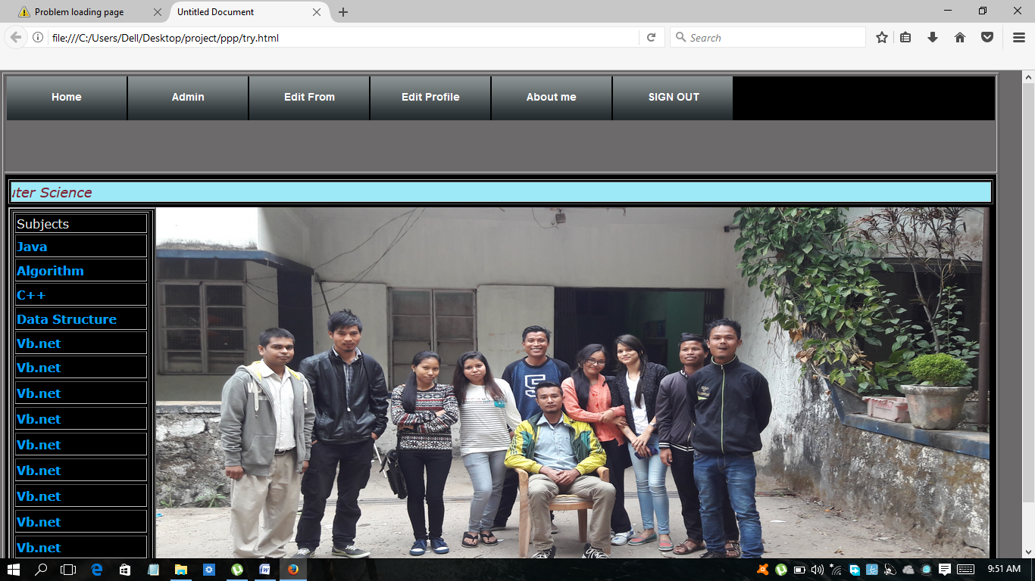
Main page of “COMPUTER SCIENCE DISCUSSION FORUM “

Slide 11
Thank You.

